Slide 1
Data Engineering
Lab 1

Slide 2
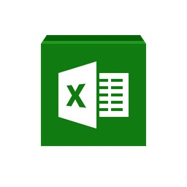
Lab pre-view
Python crawler
MLB hitter table
Xlsx file
Data pre-processing
ML prediction
DataEnLab1.ipynb - Colaboratory (google.com)

Slide 3
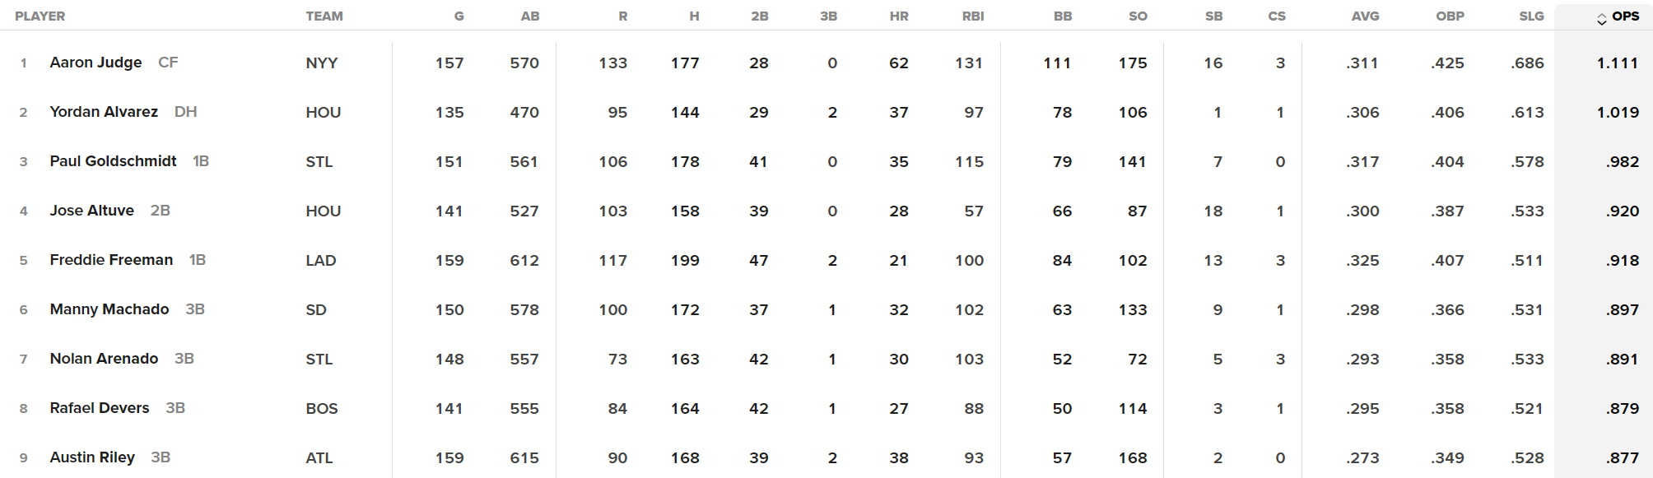
MLB data set
https://www.mlb.com/stats/2023

Slide 4
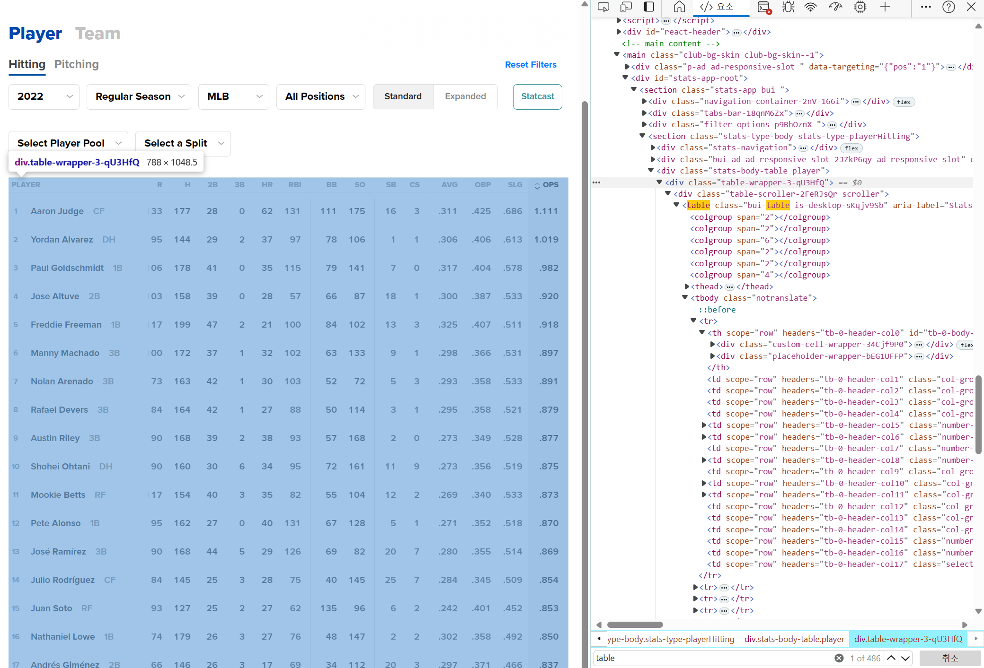
Data crawling
chrome developer tool (f12)
Data we need!

Slide 5
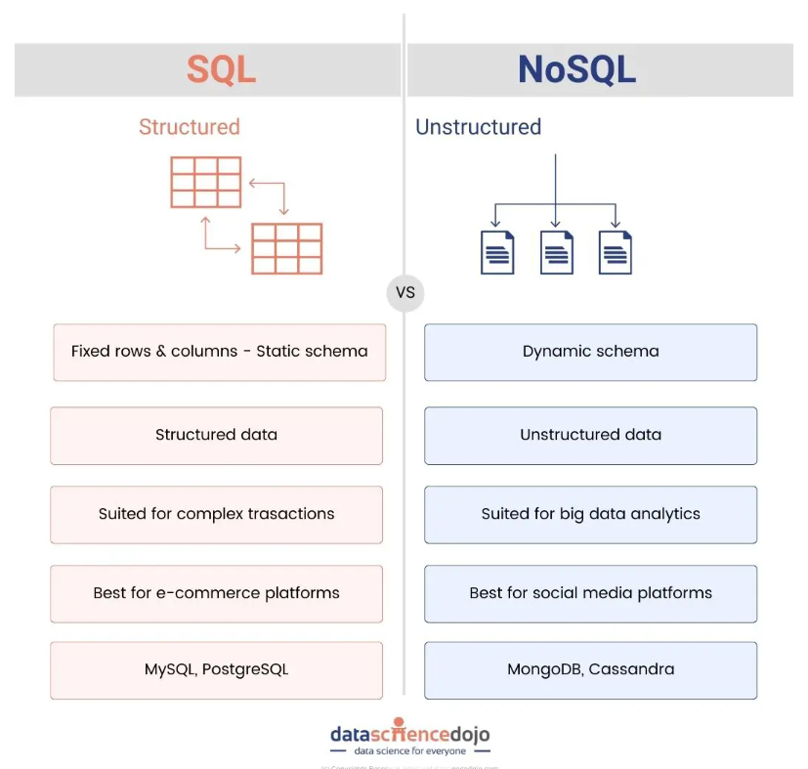
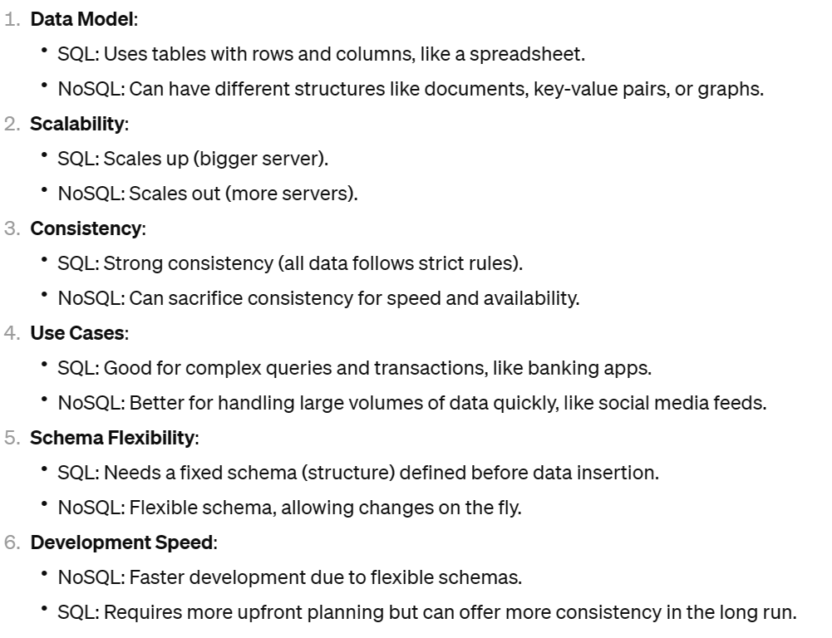
Mongo DB
SQL vs. NoSQL: Decoding the Database Dilemma for Solutions (datasciencedojo.com)

Slide 6
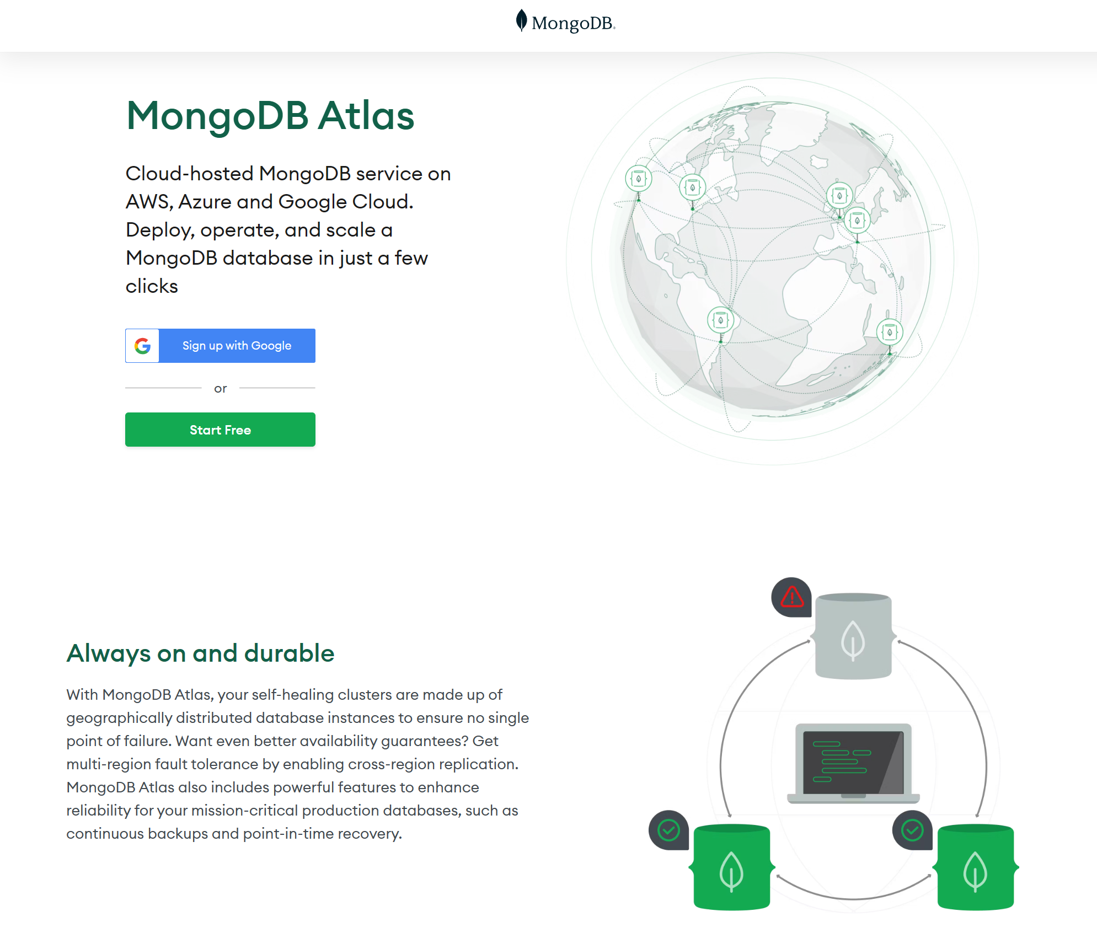
Mongo DB
Sign up with google account!
MongoDB Atlas: Cloud Document Database | MongoDB

Slide 7
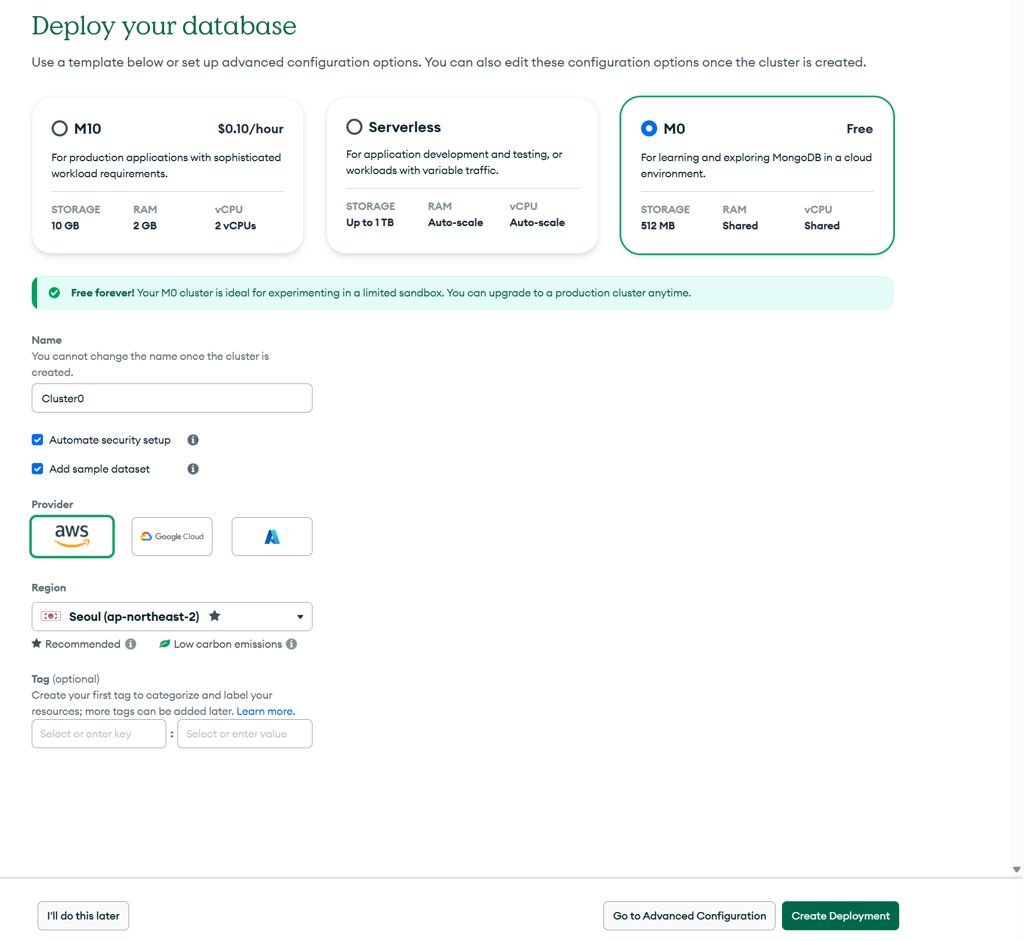
Mongo DB

Slide 8
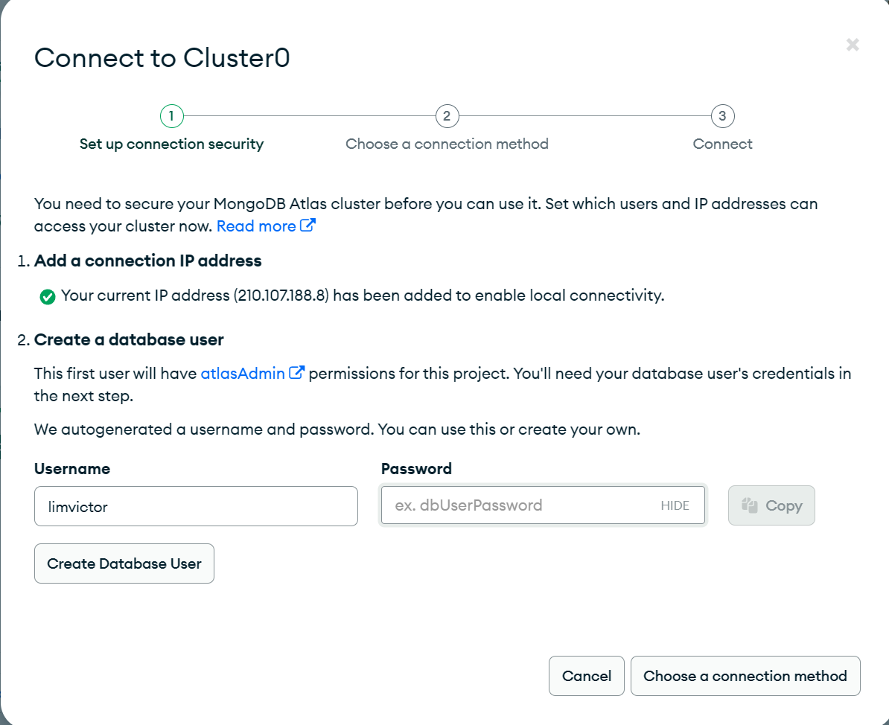
Mongo DB

Slide 9
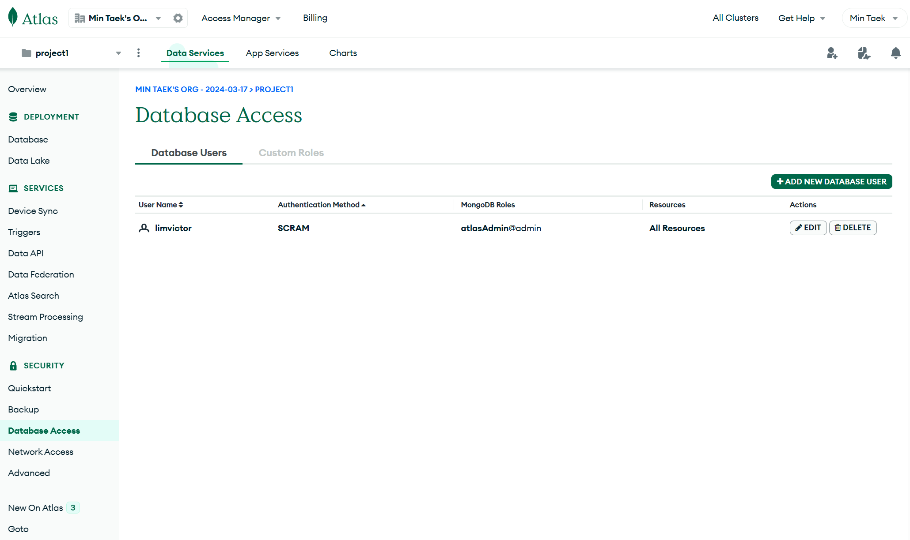
Mongo DB

Slide 10
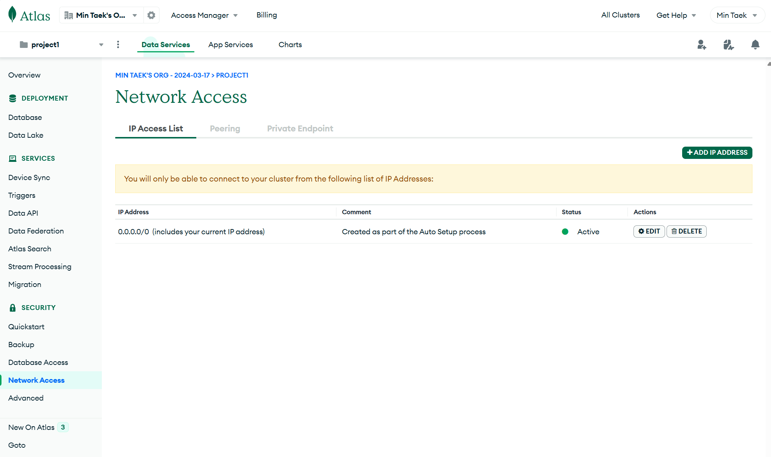
Mongo DB

Slide 11
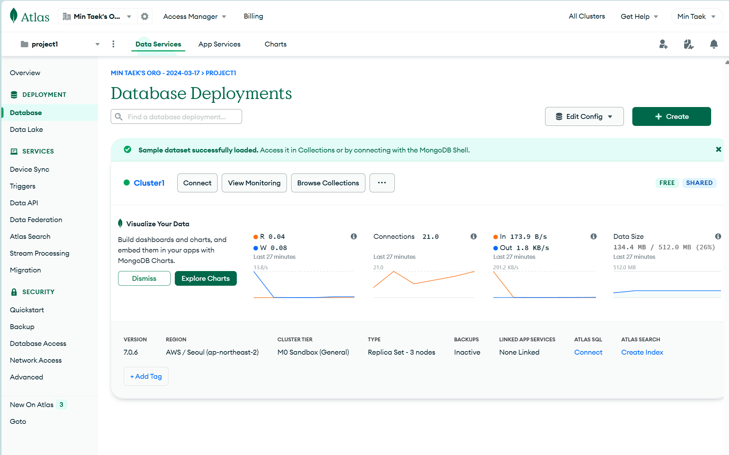
Mongo DB

Slide 12
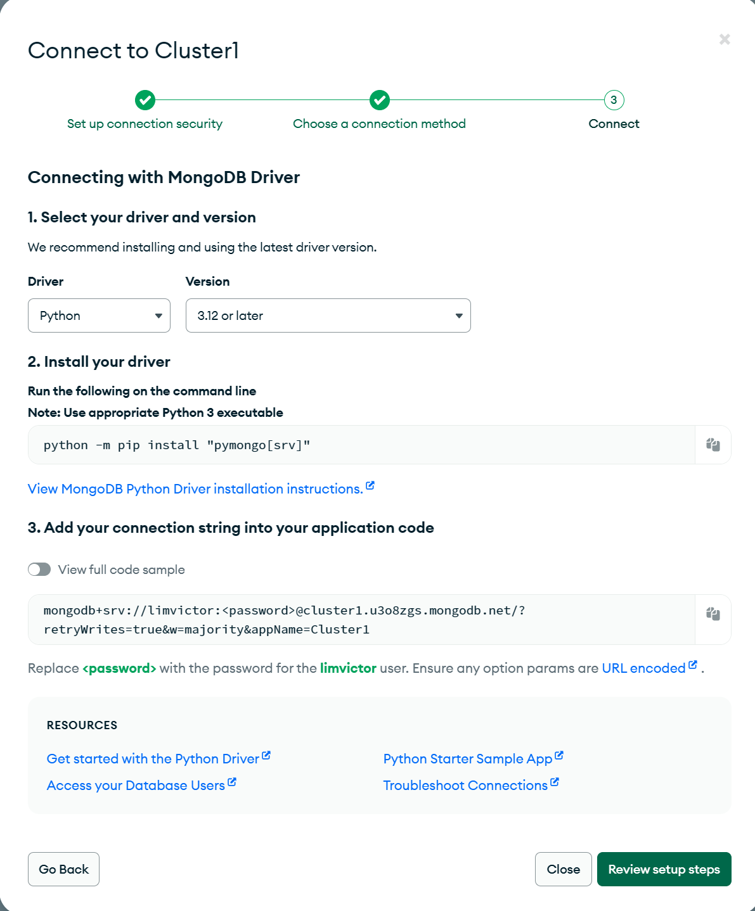
Mongo DB

Slide 13
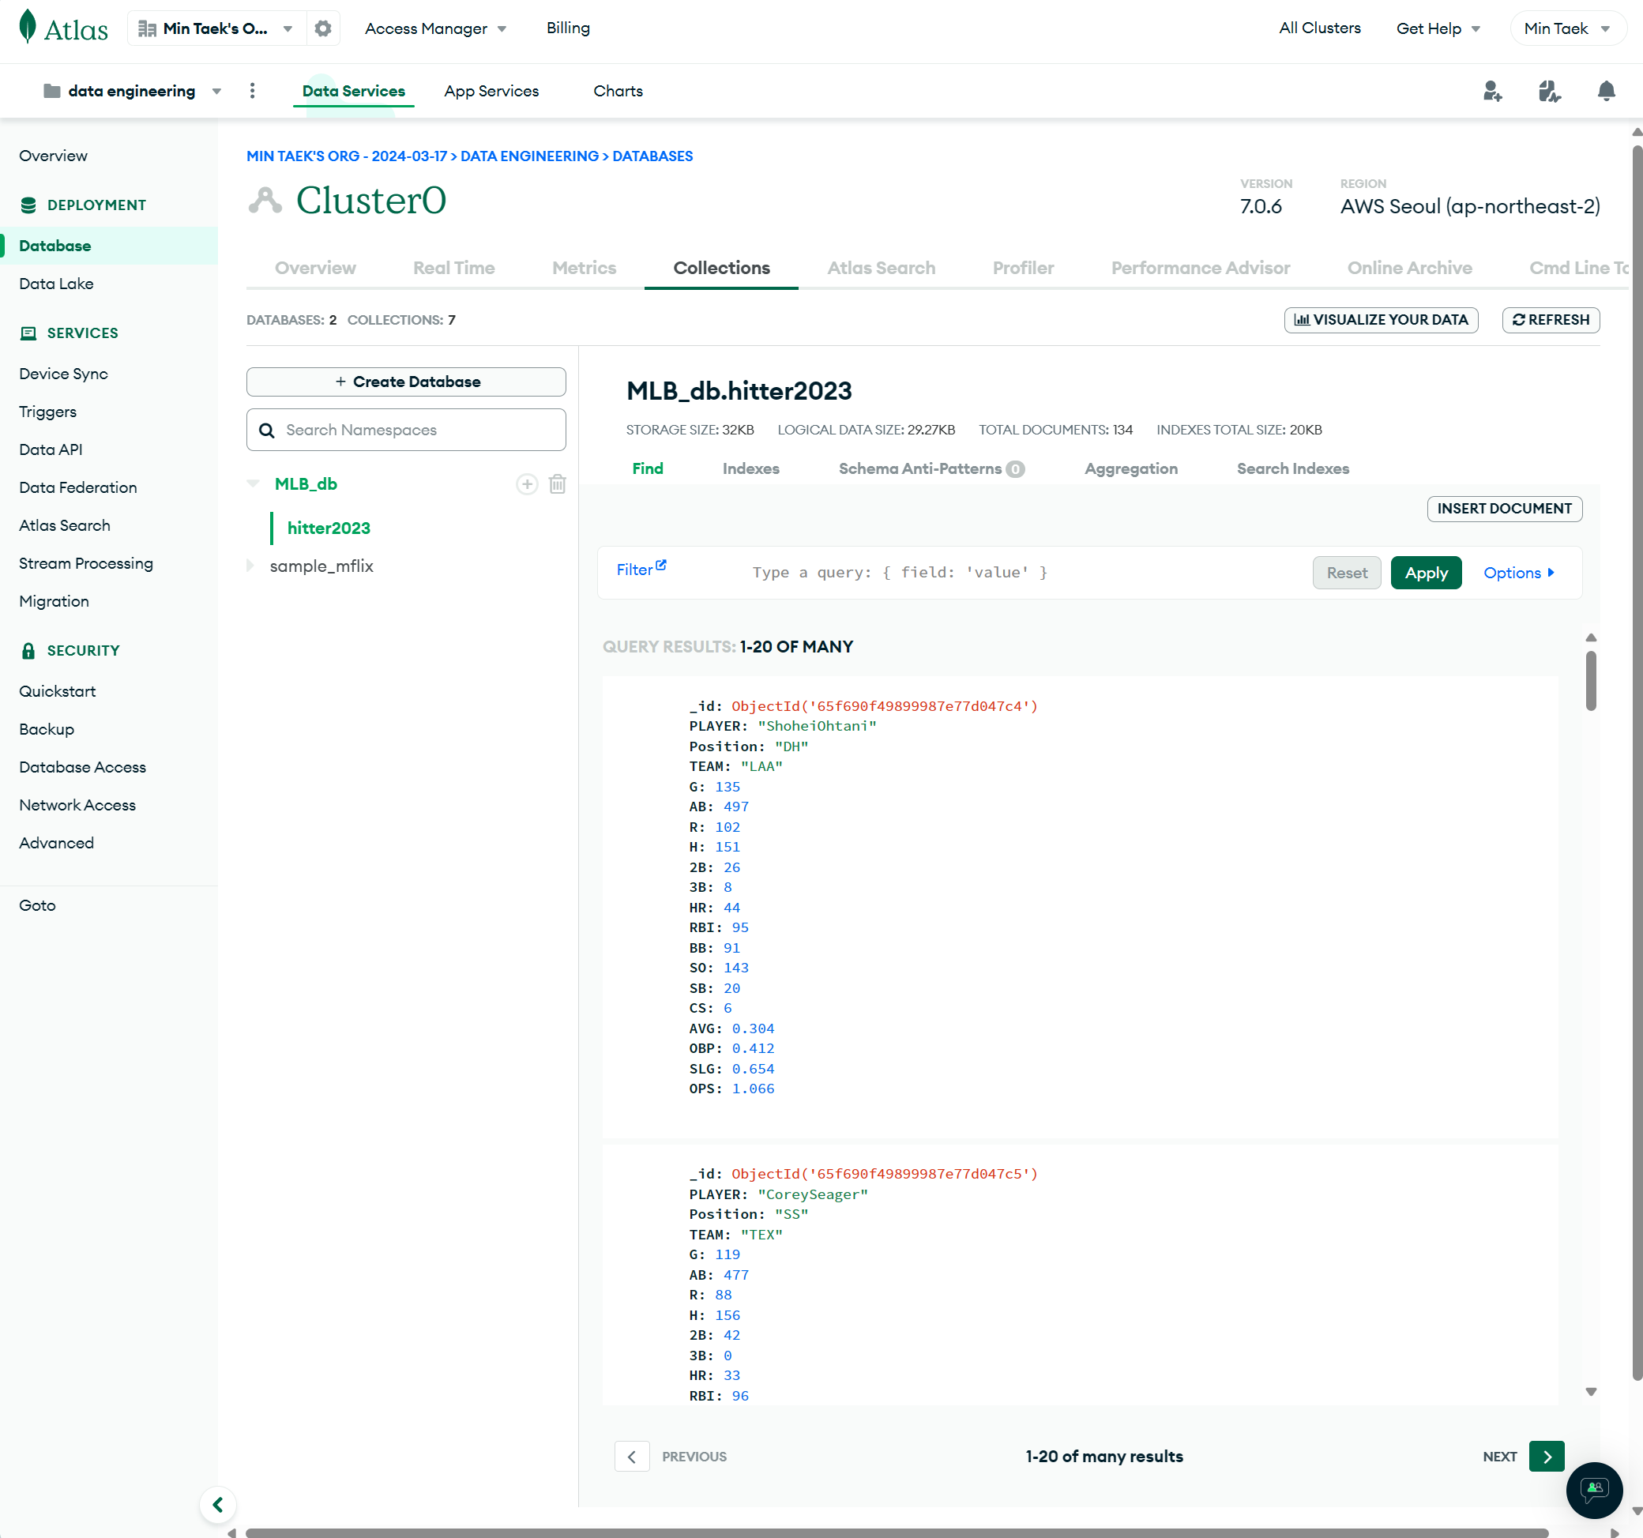
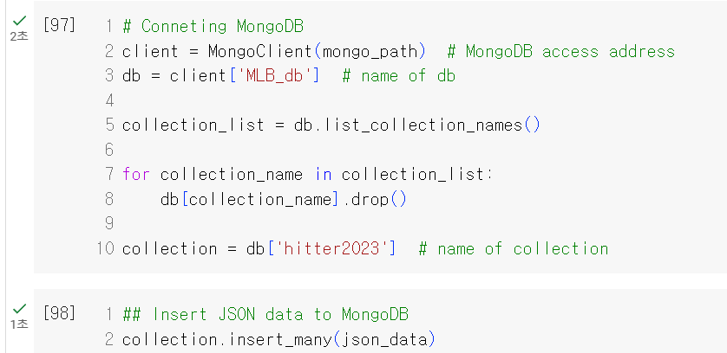
Mongo DB

Slide 14
Simple ML
Let’s predict hitter’s Home Run from other stats

